Slide 1
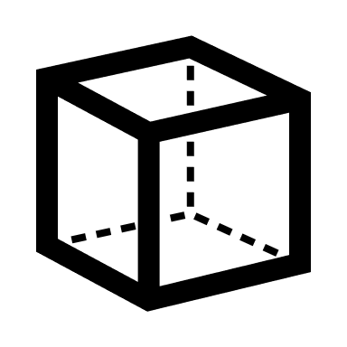





AM - CAx Analytics
Design and build 3D-CAD model.
Engineering simulation and analysis
Slicing and toolpath generation
Build component/Part fabrication
Post-Processing
Quality assessment and testing
DESIGN
ENGINEERING
OPERATION
SERVICE/FEEDBACK
Notes:
A quick reminder of the recommendations

Slide 2
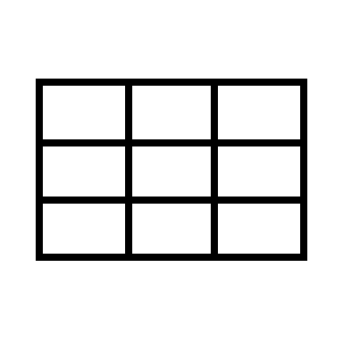

Use of information model for structuring AM-CAx information
CAx data contain inherent useful information for the selection of process parameters for an AM build.
CAD data: Mesh Information
CAE data: Simulation / Analysis information
Material information (Mechanical)
CAM Data: Manufacturing / Process data
Build Information
Material information
QC/QA data: Testing and measurement data
CAD Model
QA/QC & Testing.
CT SCAN data
NDT data
CAE Simulation and Analysis
CAM Tool / Slicing Engine
In-Situ data from AM machine
Post-Processing data
Datasets
Unified Data Model
Data Preparation and cleaning
Data Visualization
Machine learning techniques
Artificial Intelligence algorithms
Notes:
Why are we doing this ??
This will provide us options with
explore automation of AM workflow,
defect detection,
correlation of end factors with product process variables
Enhanced process flow understanding

Slide 3

Impact of Data Analytics
Data collection
Data Preparation and cleaning
Data Visualization
Machine learning techniques
Artificial Intelligence algorithms
Advantages
Disadvantages
Improved process intelligence
Significant time and resources
Cost reduction
Improved decision making
High error susceptibility
Achieve higher levels of customization
Automation capabilities
Proper interpretation of results
Improved innovation
Predictive modelling capability
Data acquisition across domains
Notes:
A quick reminder of the recommendations

Slide 4
Process Control in Additive Manufacturing
Input
Process (AM)
Output
In-Situ
Ex-Situ
In-Situ Process control
Ex-Situ Process control
Melt pool monitoring sensors
Emission monitoring sensors from process
Thermal
Acoustic
Electromagnetic
Porosity analysis and modelling using µ-CT Scan.
3D point cloud based geometric and dimensional assessment
Notes:
General forms of process control. Why do we do this….
Security and output control

Slide 5
Data Analytics in AM - CAx
Data Collection
Data Preparation and cleaning
Analysis/Processing Techniques and Algorithms
Data Visualization
Machine Sensors
Data Profiling
Machine learning techniques
Charts/Graphing
Optical Microscopes
Detain and Distilling
Artificial Intelligence algorithms
Maps
IR/Thermal Cameras
Assess Data Quality
Custom Algorithms
Tables
X-ray Modules
Documenting (metadata)
Data Delivery

Slide 6
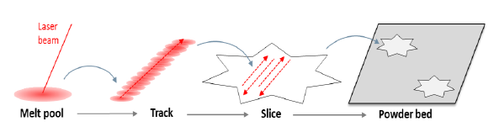
PBF process – product variables
Control Process Variables
Product Variables
Laser Speed
Geometric Deviation
Laser Power
Dimensional Deviation
Spot Size
Strength
Layer Thickness
Hardness
Gas Flow Rate and Pattern
Toughness
Scanning Pattern
Fatigue
Powder Size
Residual Stress
Packing Density
Voids
Melt pool size
Melt pool temperature
Un-melted zones
Surface Roughness
Melt pool geometry
Shrinkage
Hot/cold zones
Residual stress build-up
Porosity
Monitored Process Variables
Other defects

Slide 7
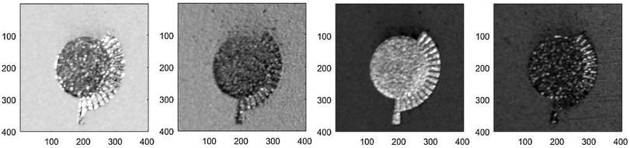
Data Collection from AM system
Signals from sensors embedded in the AM machine – Gas flow, build chamber, powder flow
Monitoring the powder bed and print layer
Powder bed layer scans and images
Powder bed and printed layer : geometrical distortions, powder bed inhomogeneity, levelling issues.
Sensor data

Slide 8
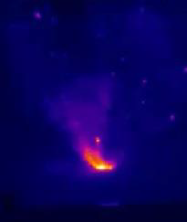
Data Collection from AM system
Scan track / laser melting zones
Melt pool monitoring
Temperature hotspots, spatters and plume give us an idea about the interaction between laser and powder bed
Temperature distribution, melting inconsistencies, melt pool geometries.
Laser interaction with powder bed
Melt pool characteristics mapping

Slide 9
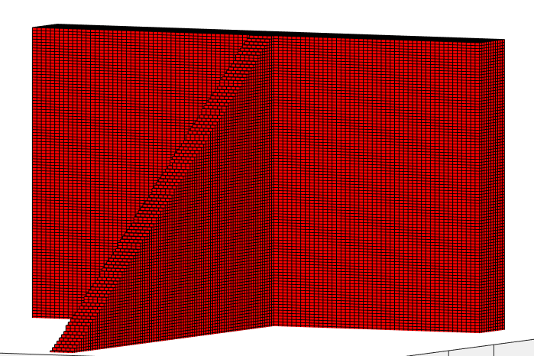
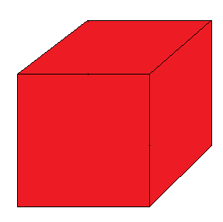
Our approach: Discretisation using voxelization
All stages of the workflow should be linked at specific points throughout the part geometry.
The 3D files from each stage of the workflow must be discretized to track changes.
Voxelization is the most suitable technique to provide geometric discretization.
This procedure allows each location on a model to be associated with the following data:
Part Data
Tool Path Data
Process Data
CT Scan Data
Analysis Data
Notes:
To represent the workflow appropriately it is necessary that all stages can be linked at specific points throughout the part geometry.
To achieve this the input files from each stage of the workflow must be discretized across the part geometry.
Voxelization has been identified as the most suitable technique to provide geometric discretization.
Pros and Cons: Computationally intensive, for better results smaller voxel sizes must be used

Slide 10
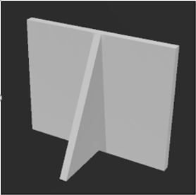
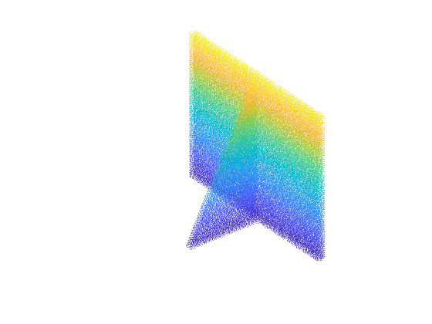
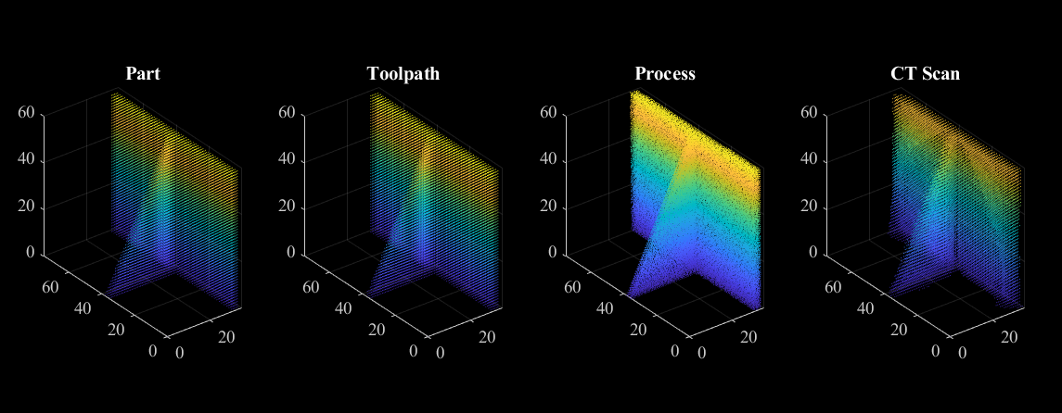
Alignment
After the data is discretized from each stage of the workflow, it is aligned with respect to each other.
This will help us associate data with different stages of the workflow
1.STL Files from each stage.
2.Voxelization of each STL.
3.Conversion from voxel model to point cloud.
4.Alignment of all point clouds.
Notes:
Presence or absence of feature, proximities to edges, orientation wrt reference
discretization of data and alignment go hand in hand. It is necessary that the voxel model from each stage of the workflow are aligned along the same orientation.
The most suitable method of doing this is by converting each voxel model to its equivalent point cloud.
There is significant amounts of literature available that explain how it is possible to align point clouds
In this case a non-rigid alignment algorithm “Coherent Point Drift” is the most suitable solution.

Slide 11
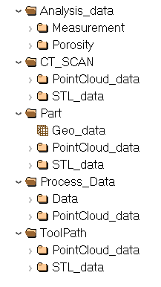
Generated unified Information Model – based on HDF5 file format.
Due to the volume of data involved the selection of the correct data management format is important.
HDF5 is a hierarchal dataset that is deemed most suitable in which to build the information model
A MATLAB script has been developed that carries out the necessary discretization and alignment tasks on all files before writing this data to a single HDF5 file.
Notes:
Once the information across the AM workflow has been discretized and aligned it can be stored.
Due to the volume of data involved the selection of the correct data management format is important.
HDF5 is a hierarchal dataset that is deemed most suitable in which to build the information model
A MATLAB script has been developed that carries out the necessary discretization and alignment tasks on all files before writing this data to a single HDF5 file.

Slide 12
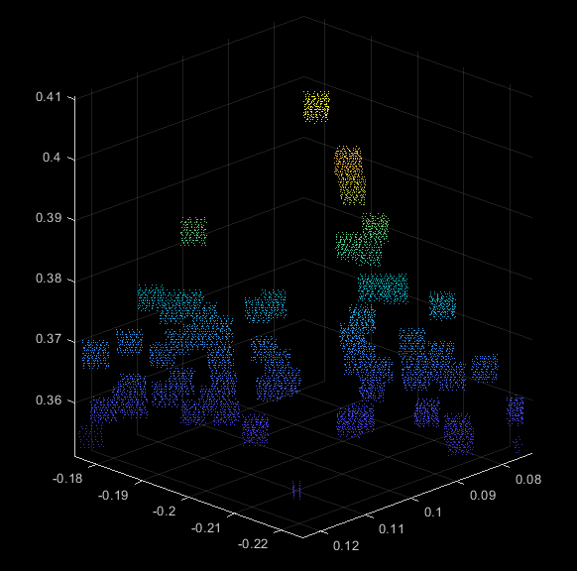
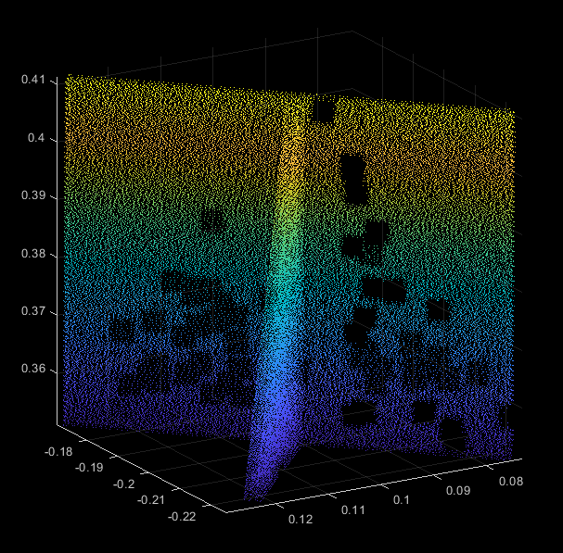
Data Preparation
For efficient discovery of data pattern, it is essential to create a comprehensive and well documented dataset.
It should make use of shared and managed storage – a relational database, network file system or big data repository
The raw data must be cleaned and processed to be documented with metadata.
Deliver the data in a suitable format for the end-user with descriptive information.
Defective regions of interest
Non-defective regions of interest

Slide 13
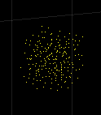
Analysis/Processing Techniques and Algorithms
The expected output of an algorithm will be based on whether the dataset features within a region of interest are likely to form a relationship or pattern.
Compounded learning models, filters on datasets would be required to form meaningful relationships between the data variables.
Dataset features
Learning Model / Algorithm
No defect predicted
Defect is predicted

Slide 14
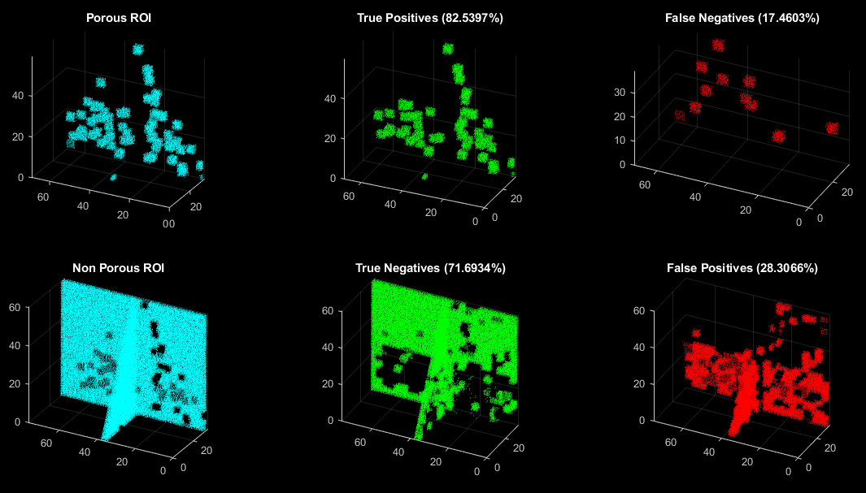
Data Visualization
Visualization of results of a test algorithm

Slide 15
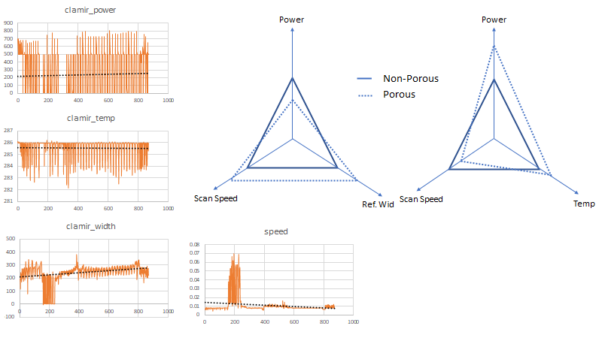
Potential Solution
Laser Power
Selection of baseline for machine and process parameters, based on previous observations on build quality.
Deviation from ideal range of parameters, could lead to an anomaly.
With further refinements, this model could be developed for active in-situ process control.
Laser Temp.
Melt-pool Width
Scan Speed

Slide 16
Monitoring systems currently available in AM
Monitoring System | Developer | Monitor zone | Type
QM meltpool 3D | Concept Laser | Melt poot (area and intesity) | Co-axial photodiodes
QM Coating | Concept Laser | Powder bed | Off-axial camera
EOSTATE Meltpool | EOS | Melt pool | Co-axial and off-axial sensors
EOSTATE PowderBed | EOS | Powder bed | Off-axial camera
EOSTATE Exposure OT | EOS | Thermal map of powder bed | Off-axis camera
Meltpool monitoring (MPM) system | SLM Solutions | Melt pool | Co-axial pyrometer
Laser Control System (LCS) | SLM Solutions | Powder bed | Off-axial camera
MeltView | Renishaw | Melt pool | Co-axial photodiodes
LaserView | Renishaw | Powder bed | Co-axial photodiodes
 | Aconity3D | Melt pool | Co-axial photodiodes and CMOS Camera
Truprint Monitoring | Trumpf | Melt pool | Co-axial photodiodes
Truprint Monitoring | Trumpf | Powder bed and part geometry | Off-axial camera
 | SISMA | Powder bed | Off-axial camera
LayerQam | Arcam | Intensity map in a layer | Off-axial camera
Xqam | Arcam | X-ray Emissions | X-ray detector
PrintRite3D | B6 Sigma | End-to-end monitoring system | Co-axial and off-axial sensors

Slide 17
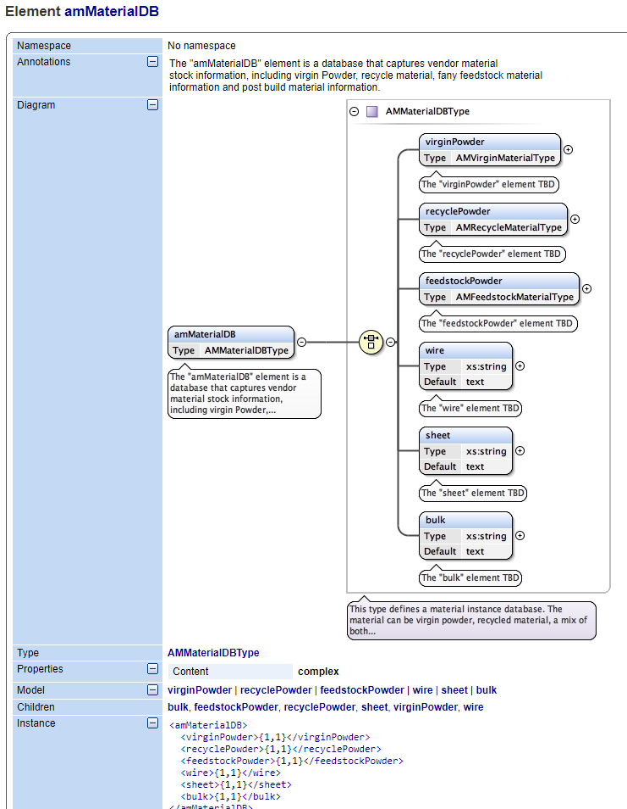
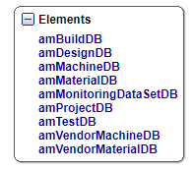
Future steps: Structuring the data using a Standard AM Schema
A data schema is a database with a data structure, described and supported by the database management system.
Here, the data is organized in different classes according the nature and volume of data.

Slide 18
Thank you

